Slide 1


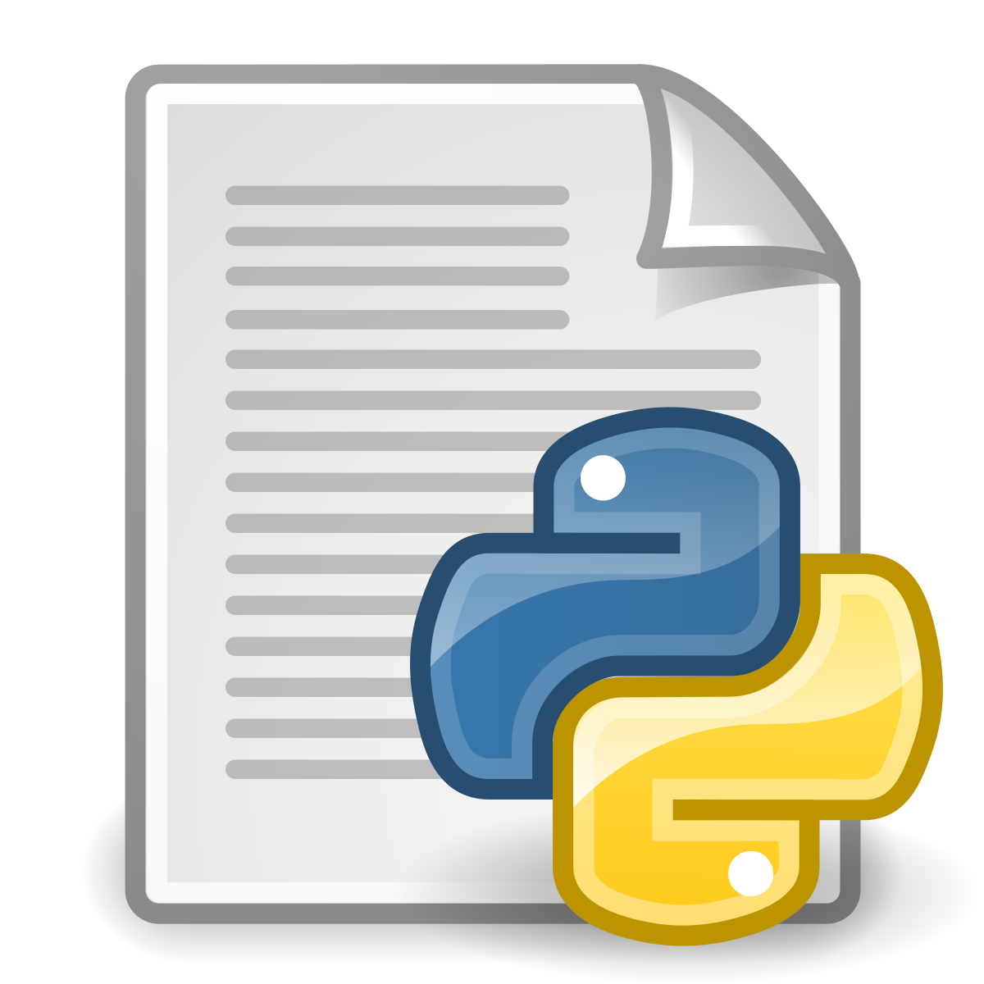

KIVY - Python file into APK file

Slide 2
Linux command
9. sudo apt-get install libltdl-dev libffi-dev libssl-dev autoconf autotools-dev
10. sudo apt install -y git zip unzip openjdk-8-jdk python3-
pip autoconf libtool pkg-config zlib1g-dev libncurses5-dev libncursesw5- dev libtinfo5 cmake libffi-dev libssl-dev
11. pip3 install --user -- upgrade Cython==0.29.19 virtualenv
add the following line at the end of your ~/.bashrc file
12. export PATH=$PATH:~/.local/bin/
Kivy app to apk (Buildozer)
13. git clone https://github.com/kivy/buildozer.git
14. cd buildozer
15. sudo python3 setup.py install
16. cd ..
17. buildozer init
18. buildozer android debug
(check for the bin directory -> apk)
https://bootstrap.pypa.io/get-pip.py
sudo apt-get install python3-distutils
sudo python3 get-pip.py
sudo apt-get install -y python3-pip build-essential git python3 python3-dev
sudo apt-get install -y libsdl2-dev libsdl2-image-dev libsdl2-mixer-dev libsdl2-ttf-dev libportmidi-dev libswscale-dev libavformat-dev libavcodec-dev zlib1g-dev
sudo apt-get install cython
sudo pip3 install kivy
python3 main.py - code is available

Slide 3
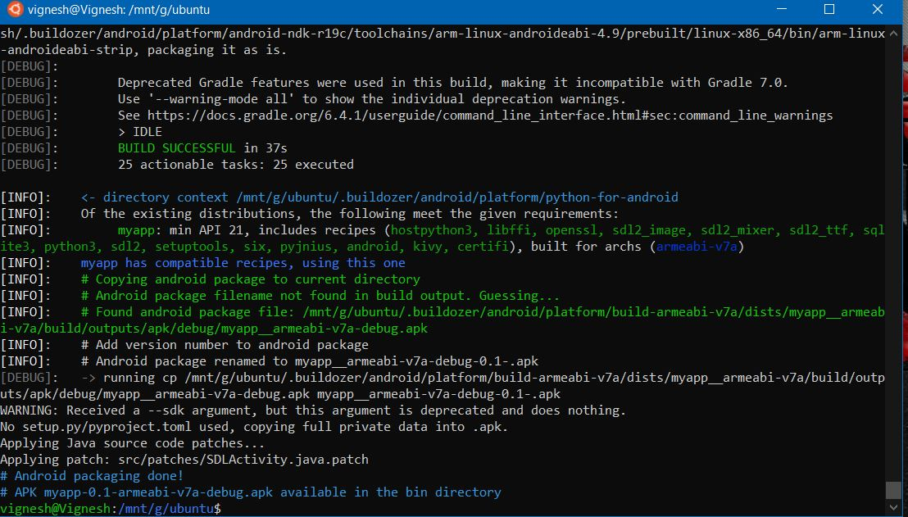
Make sure the Linux command path is on main.py (kivy program) location
Install Python
Step 1 --> For accessing pip command in Linux window
Step 8 --> change the progarm file name as main.py
Step 12 --> For environment variable - Temporarily
Step 13 --> For downloading buildozer file
App available in the bin folder

Slide 4
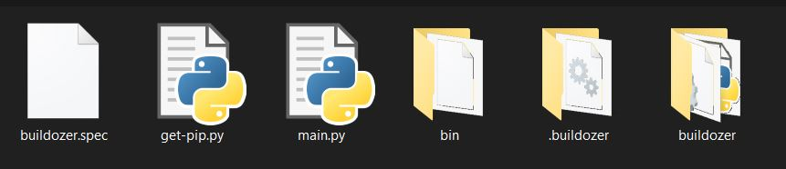
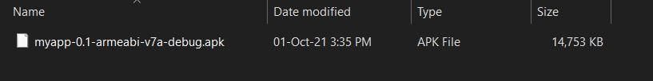
After Linux command executed successfully
APK file (available in bin folder)

